Slide 1

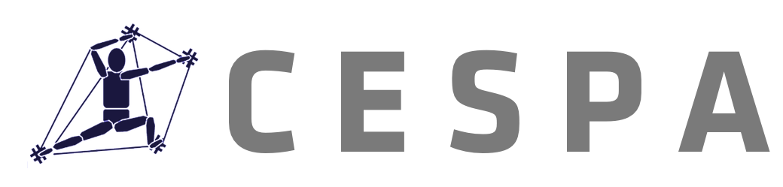
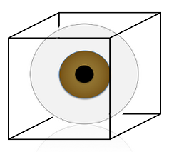
Compatibility Effects in Bistable Perception of the Necker Cube
T. R. Brooks | Till Frank | James Dixon
T. R. Brooks
ICPA 19 | Seoul, Korea

Slide 2
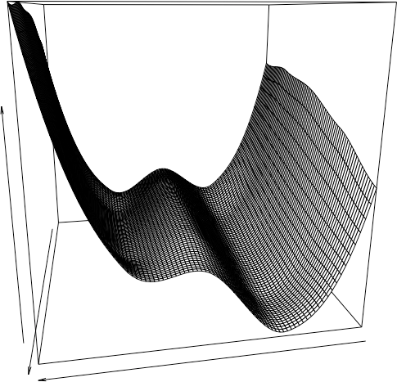
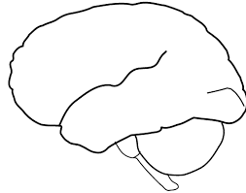
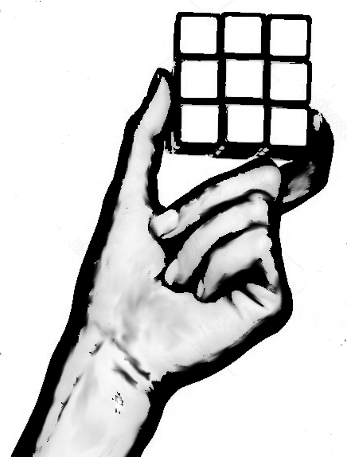
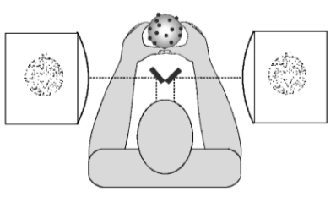
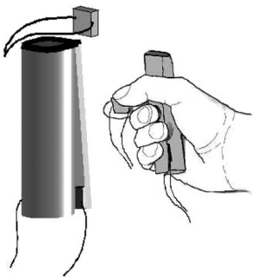
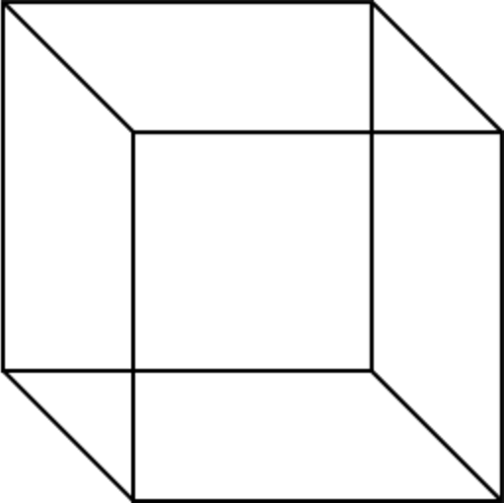
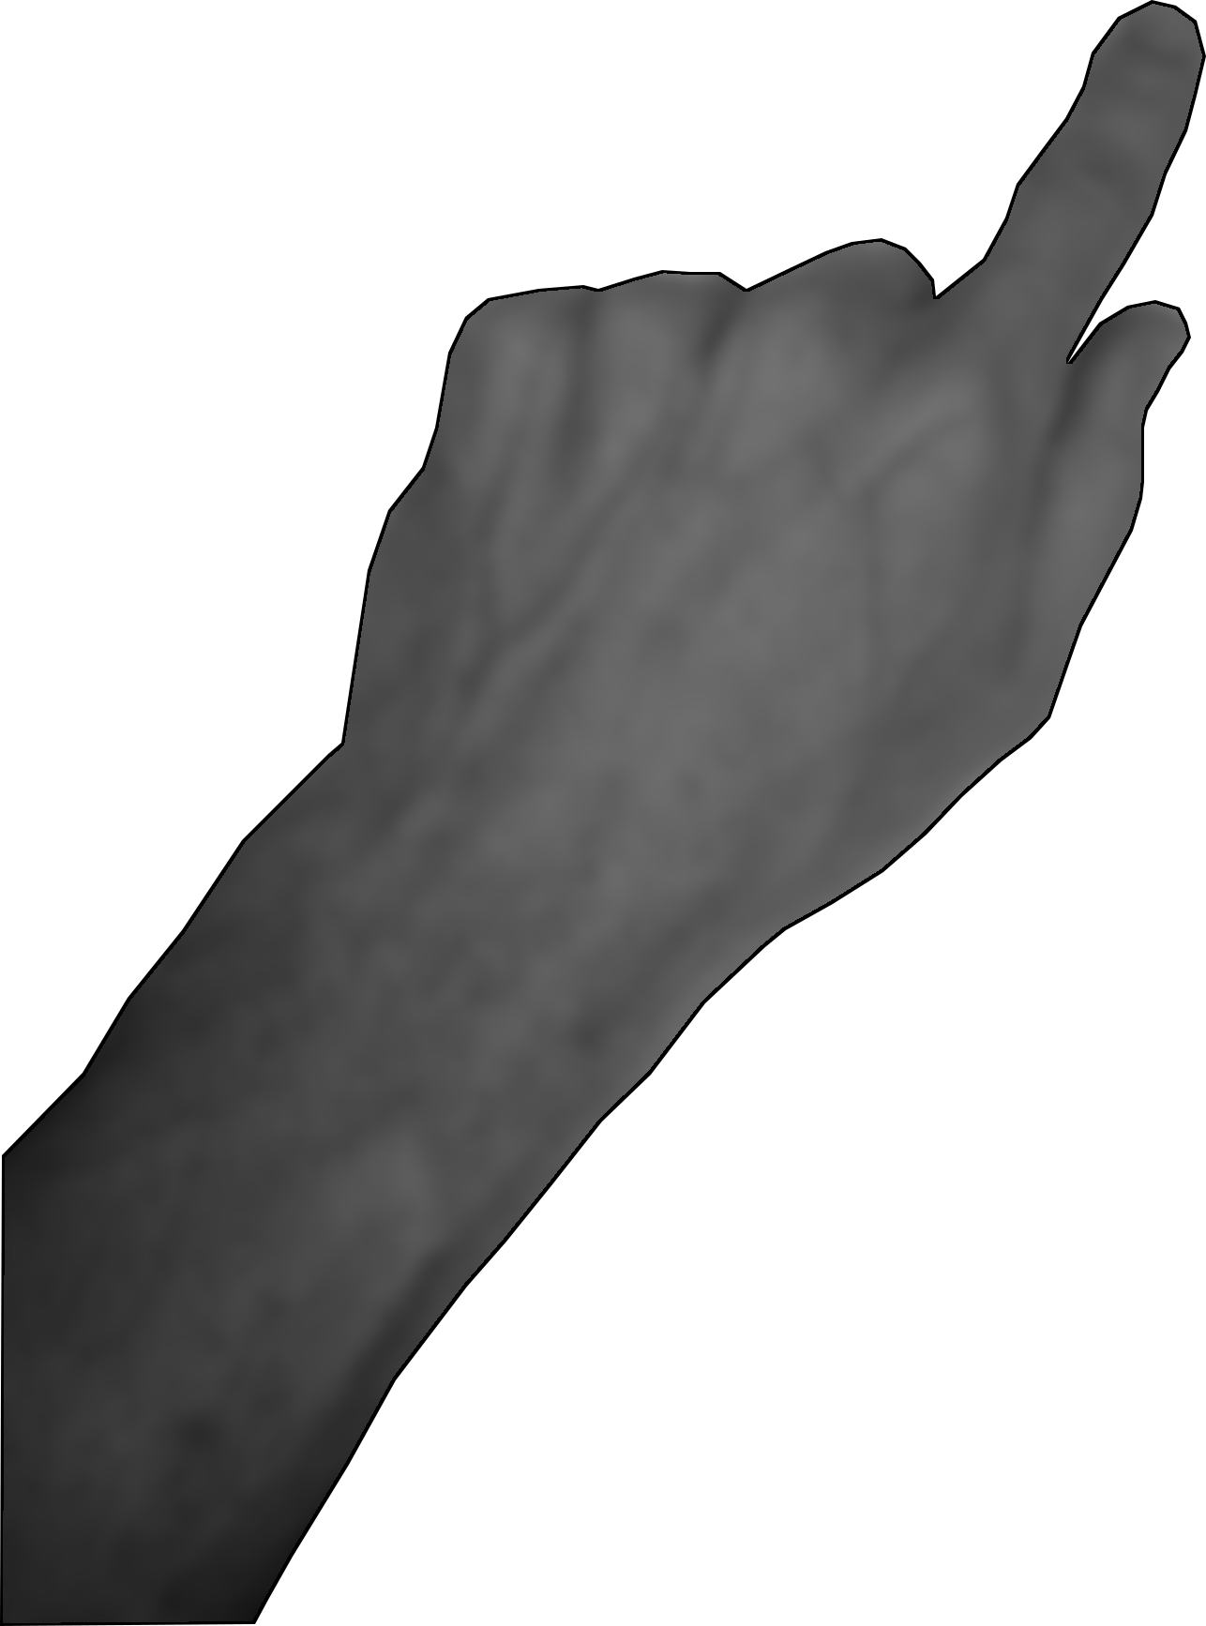
DORSAL
“Multisensory Integration”
What are the “rules” for combining?
Information “boosts a signal”¹
Ecological approach
Combined elements detected directly.
A “landscape” of perception/action space²
Visual
VENTRAL
Haptic
→ What would an ecological version of these experiments look like?
Stimulus/Response integrated. The report is the task.
Should track development over time (perceptual learning).
Stimulus-Response Compatibility
Bistable Perception
*
Report
State
“Micro-affordance³”
Time
T. R. Brooks
ICPA 19 | Seoul, Korea
³Ellis et al., 2007.
¹Tong, Meng, & Blake, 2006.
²Stoffregen & Bardy, 1997.
Notes:
Add in part/whole image?

Slide 3
Multisensory Integration, SRC, Embodied Cognition
Actions and body position are one aspect of context because of the sensations generated.
Just need to get stimulus and response into a common code.
Seen as a possible compromise between computational and ecological approaches¹
The same presupposition that separates perception from action separates stimulus from response.
What would these experiments look like without this assumption?
*
State
Report
Time
Boosting, Suppression → Selection, Veto
Experiment Goals:
Includes stimulus-response compatibility and “multisensory integration”
Links stimulus-response (perception-action) into a single task. The report is the task.
Tracks perceptual learning.
Conflicting info presented to each eye
Rotating textured globe felt with hands
Reported using foot
→ Passive stimulation
→ Irrelevant action
T. R. Brooks
ICPA 2017 | Seoul, Korea
¹Ellis & Tucker (2000).
²Blake, Sobel, & James (2004).

Slide 4
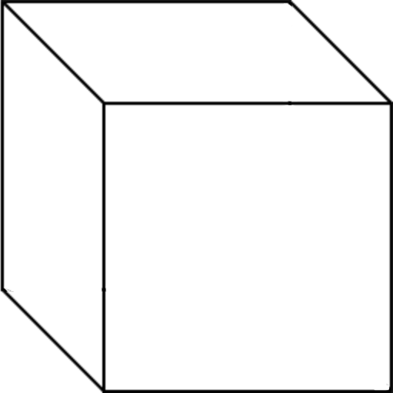
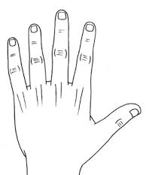
The Experiment
Compatible Condition
Participants viewed a bistable image and reported its orientation.
Cube-shaped lever used for report
An additional exterior figure was provided to show the participant what was being reported.
Compatibility of lever with exterior cube was manipulated
Outer figure controlled using lever
Inner figure (Necker cube) appears to change orientations spontaneously
Task: “Match the orientation of the outer figure to the apparent orientation of the inner figure using the controller”
T. R. Brooks
ICPA 19 | Seoul, Korea
Notes:
Mention ellis & tucker?

Slide 5
The Experiment
Incompatible Condition
Participants viewed a bistable image and reported its orientation.
Cube-shaped lever used for report
An additional exterior figure was provided to show the participant what was being reported.
Compatibility of lever with exterior cube was manipulated
Outer figure controlled using lever
Inner figure (Necker cube) appears to change orientations spontaneously
Disadvantage: Task no longer differentiates perception from action, stimulus from response, or attention from intention.
Advantage: Task no longer differentiates perception from action, stimulus from response, or attention from intention.
Task: “Match the orientation of the outer figure to the apparent orientation of the inner figure using the controller”
T. R. Brooks
ICPA 19 | Seoul, Korea

Slide 6
Training phase
Large cube is controlled using lever.
Small cube spontaneously reorients every ~2 to 6 seconds
Display viewed by participant
Cube-shaped lever controlled by participant
T. R. Brooks
ICPA 2017 | Seoul, Korea

Slide 7
Training phase
Large cube is controlled using lever.
Small cube spontaneously reorients every ~2 to 6 seconds
Task: match the orientation of the large figure to the smaller figure.
Display viewed by participant
Cube-shaped lever controlled by participant
T. R. Brooks
ICPA 2017 | Seoul, Korea

Slide 8
Training phase
Large cube is controlled using lever.
Small cube spontaneously reorients every ~2 to 6 seconds
Task: match the orientation of the large figure to the smaller figure.
Display viewed by participant
Cube-shaped lever controlled by participant
T. R. Brooks
ICPA 2017 | Seoul, Korea

Slide 9
Training phase
Large cube is controlled using lever.
Small cube spontaneously reorients every ~2 to 6 seconds
Task: match the orientation of the large figure to the smaller figure.
Display viewed by participant
Cube-shaped lever controlled by participant
T. R. Brooks
ICPA 2017 | Seoul, Korea

Slide 10
Training phase
Large cube is controlled using lever.
Small cube spontaneously reorients every ~2 to 6 seconds
Task: match the orientation of the large figure to the smaller figure.
Display viewed by participant
Cube-shaped lever controlled by participant
T. R. Brooks
ICPA 2017 | Seoul, Korea

Slide 11
Training phase
Large cube is controlled using lever.
Small cube spontaneously reorients every ~2 to 6 seconds
Task: match the orientation of the large figure to the smaller figure.
Display viewed by participant
Cube-shaped lever controlled by participant
T. R. Brooks
ICPA 2017 | Seoul, Korea

Slide 12
Training phase
Large cube is controlled using lever.
Small cube spontaneously reorients every ~2 to 6 seconds
Task: match the orientation of the large figure to the smaller figure.
Display viewed by participant
Cube-shaped lever controlled by participant
T. R. Brooks
ICPA 2017 | Seoul, Korea

Slide 13
Training phase
Compatible
Incompatible
Large cube is controlled using lever.
Small cube spontaneously reorients every ~2 to 6 seconds
Task: match the orientation of the large figure to the smaller figure.
Display viewed by participant
In the incompatible condition, the lever is oriented opposite the large cube
Cube-shaped lever controlled by participant
T. R. Brooks
ICPA 2017 | Seoul, Korea

Slide 14
Large cube is controlled using lever.
Small cube spontaneously reorients every ~2 to 6 seconds
Task: match the orientation of the large figure to the smaller figure.
Display viewed by participant
In the incongruent condition, the lever is oriented opposite the large cube
Cube-shaped lever controlled by participant
T. R. Brooks
ICPA 2017 | Seoul, Korea

Slide 15
Training phase
Compatible
Incompatible
Large cube is controlled using lever.
Small cube spontaneously reorients every ~2 to 6 seconds
Task: match the orientation of the large figure to the smaller figure.
Display viewed by participant
In the incongruent condition, the lever is oriented opposite the large cube
Cube-shaped lever controlled by participant
T. R. Brooks
ICPA 2017 | Seoul, Korea

Slide 16
Training phase
Compatible
Incompatible
Large cube is controlled using lever.
Small cube spontaneously reorients every ~2 to 6 seconds
Task: match the orientation of the large figure to the smaller figure.
Display viewed by participant
In the incongruent condition, the lever is oriented opposite the large cube
Cube-shaped lever controlled by participant
T. R. Brooks
ICPA 2017 | Seoul, Korea

Slide 17
Training phase
Compatible
Incompatible
Large cube is controlled using lever.
Small cube spontaneously reorients every ~2 to 6 seconds
Task: match the orientation of the large figure to the smaller figure.
Display viewed by participant
In the incongruent condition, the lever is oriented opposite the large cube
Cube-shaped lever controlled by participant
T. R. Brooks
ICPA 2017 | Seoul, Korea

Slide 18
Training phase
Compatible
Incompatible
Test phase
Compatible
Incompatible
Large cube is controlled using lever.
Static Necker cube appears to reorient every few seconds
+
Task: match the orientation of the large figure to the Necker cube.
Display viewed by participant
Cube-shaped lever controlled by participant
T. R. Brooks
ICPA 2017 | Seoul, Korea

Slide 19
Training phase
Compatible
Incompatible
Test phase
Compatible
Incompatible
Large cube is controlled using lever.
Static Necker cube appears to reorient every few seconds
+
Task: match the orientation of the large figure to the Necker cube.
Display viewed by participant
In the incongruent condition, the lever is oriented opposite the large cube
Cube-shaped lever controlled by participant
T. R. Brooks
ICPA 2017 | Seoul, Korea

Slide 20
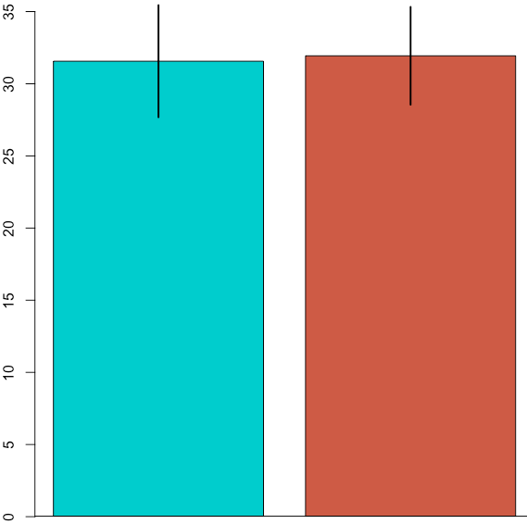
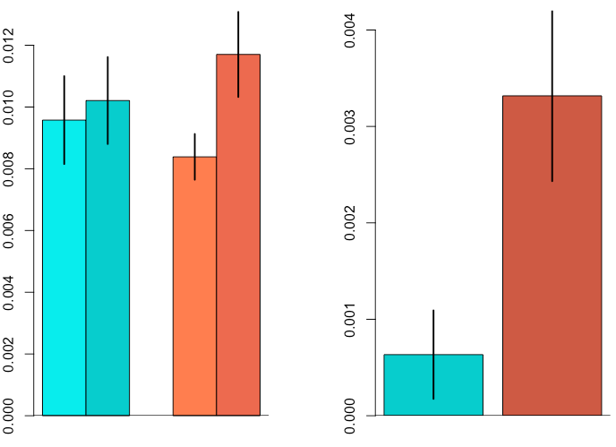
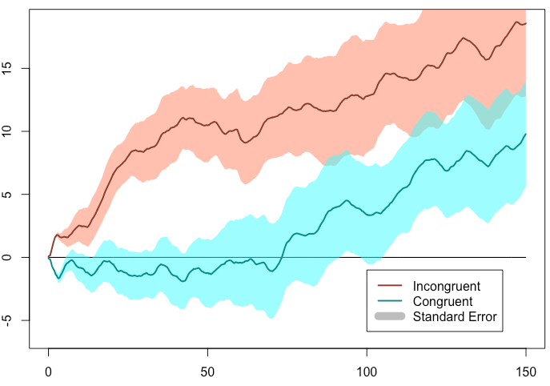
Results
Did the signals “boost” each other?
Are preferences affected?
Markov Coefficients
𝝰 = p (down-to-up)
𝝱 = p (up-to-down)
What should we expect according to MI?
Visual and haptic signals “boost” each other
H1: Fewer switches in the compatible condition
H2: Greater preference for one position over the other in the congruent condition (due to stabilizing influence.)
What should we expect according to EP / GA theory?
Visual and haptic information “warps” landscape of perception/action states
H1: Same as above, but evolves over time
H2: Some (non-obvious) effect that is different from above, which evolves over time
𝝱 - 𝝰
Number of Switches
𝝰
𝝱
𝝰
𝝱
Compatible
Incompatible
Compatible
Incompatible
Compatible
Incompatible
Preference for down position
Assumed that development is occurring
Participants preferred the “down” orientation
Preference was realized sooner in incongruent condition
Time
ICPA 19 | Seoul, Korea
Notes:
Add in experiment schematic at bottom?

Slide 21
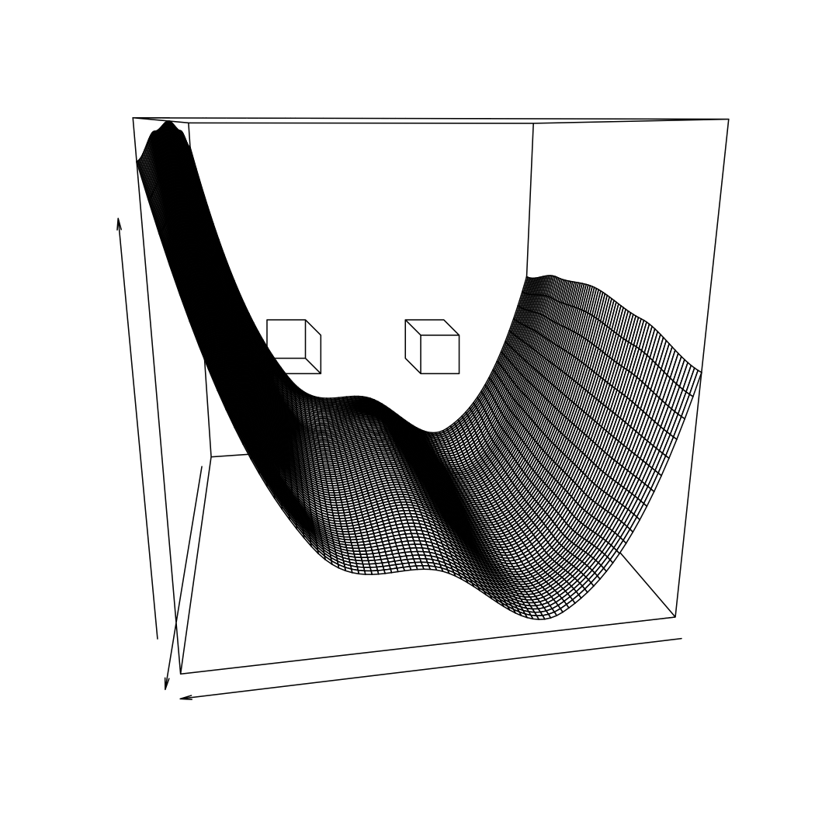
Conclusions
Multisensory perception is more (or different) than “boosting a signal”.
The landscape conception is more appropriate because of what it does not assume:
perception - action, stimulus – response separate processes
Influence constant over time (stationary)
What does the landscape conception tell us about what is happening with bistable perception?
Change in amount of noise in system over time
Change in attractor strength over time
Compatibility effects as initial conditions
ICPA 19 | Seoul, Korea
Notes:
Bring it back home to big picture
Make better plots (colors, fewer, etc.

Slide 22
This presentation file can be downloaded at:
github.com/trbrooks
ICPA 19 | Seoul, Korea

Slide 23
Training Phase (Compatible)
Order:
Compatible Training
Compatible Test
Incompatible Training
Incompatible Test
Outer figure controlled using lever
Inner figure (Necker cube) appears to change orientations spontaneously
Task: “Match the orientation of the outer figure to the apparent orientation of the inner figure using the controller”
T. R. Brooks
ICPA 2017 | Seoul, Korea

Slide 24
Training Phase (Incompatible)
Order:
Compatible Training
Compatible Test
Incompatible Training
Incompatible Test
Outer figure controlled using lever
Inner figure (disambiguatedcube) changes orientation at random intervals
Task: “Match the orientation of the outer figure to the apparent orientation of the inner figure using the controller”
T. R. Brooks
ICPA 2017 | Seoul, Korea

Slide 25
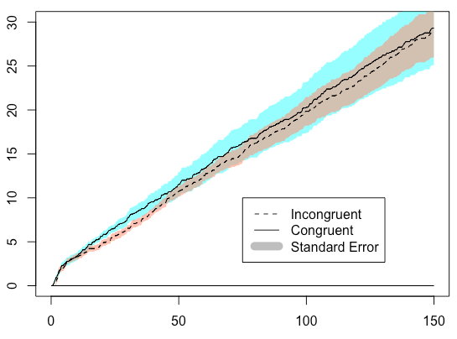
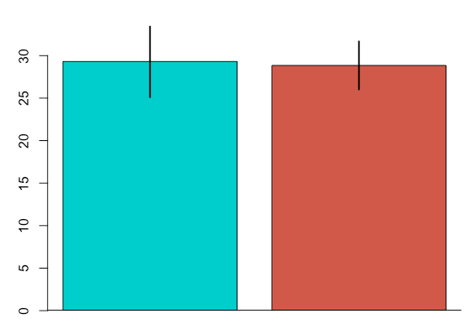
Mean running total switches
Time (Seconds)

